Slide 1
Crop rotations (APSIM 7.10)
peter.devoil@uq.edu.au
March 2021

Slide 2
Crop rotations
Options:
Multiple (crop) managers with distinct windows
Linear (calendar) sequences (eg. Operations module)
State transition network (aka bubbles)
Flexibility a key philosophy of apsim
Notes:
Bigger perspective: possible approaches

Slide 3
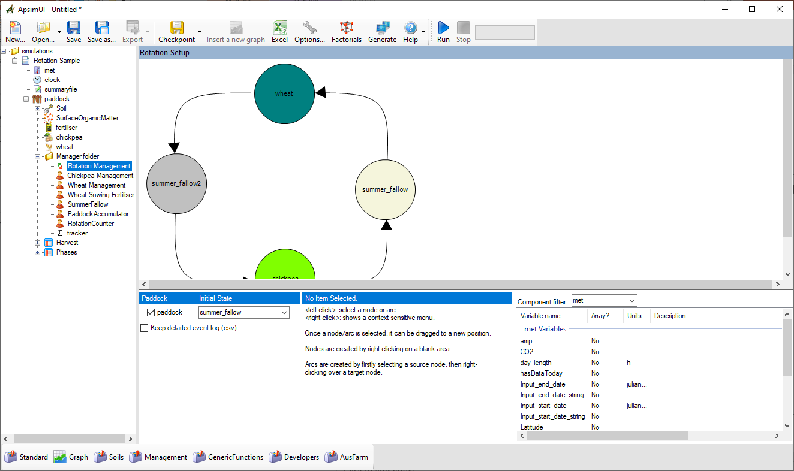
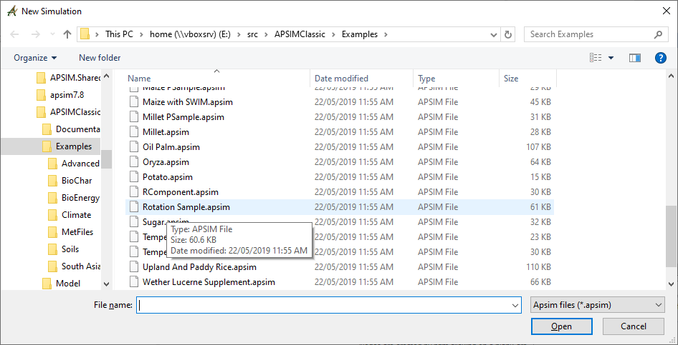
Crop rotations

Slide 4
Crop rotations
What’s different?
Bubble chart
Multiple crop managers
More outputs

Slide 5
Crop rotations
UI Operation
Notes:
Operating the UI is described in center pane

Slide 6
Crop rotations
By itself, the crop rotation manager understands very little of the components in the system.
It relies on other (usually manager) components for specific knowledge
Normally, these other manager components* behave independently if they can’t see a sequencer in the simulation.
When a sequencer is present, they simply present variables that reflect the state of the crop they’re managing (eg sowing window is open today), and respond to directions when asked (eg sow the crop today) – ie. no active role.
* Only the manager.NET rules

Slide 7
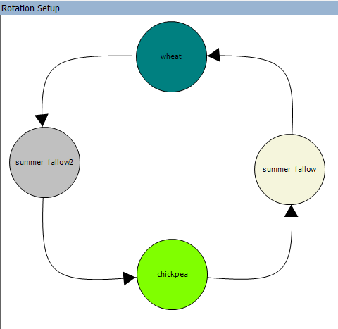
Crop rotations
The sequencer’s daily operation is simple:
Can I do anything?
If so, do it
Repeat until nothing further to do

Slide 8
Crop rotations
The sequencer’s daily operation is simple:
Can I do anything?
If so, do it
Is the chickpea crop ready to harvest?
No – do nothing
Yes – harvest, move to the next state, and see if there’s anything to do there..
Notes:
Example of a decision rule

Slide 9
Crop rotations
The sequencer asks the Chickpea Manager component whether the chickpea component is ready for harvest.
These manager rules have generic names that relate to states (enter & leave), not operations (sow & harvest).
Rules = variables → “get”
Actions = events → “publish”
Is the chickpea crop ready to harvest?
Yes – harvest, move to the next state, and see if there’s anything to do there..
Notes:
The mechanics of changing state

Slide 10
Crop rotations
Nodes are abstract – they don’t have to represent a physical state in the system
They can be ephemeral – left immediately after entry
They can be partially connected (with only entry or exit arcs)
Tips:
Don’t use whitespace in names, upper/lower case is significant
Make sure the Initial State (starting point) exists
Don’t start in a crop, start immediately before that crop would be sown
Notes:
General construction

Slide 11
Crop rotations
Arcs must have a source and destination
A rule for an arc results in just an integer. The score for an arc is the mathematical product of all its rules
When evaluating multiple arcs from a node, the highest (non-zero) arc is selected
Tips:
In rules/actions, get module names exactly right (via copy/paste) – the writing is tiny and easy to mis-spell
Start small & simple – test, and then expand the graph

Slide 12
Crop rotations
The sequencer runs on the process event of each day
The sequencer sends 3 events when changing state from X to Y:
transition_from_X,
transition, and
transition_to_Y
In addition to the explicit actions undertaken during a transition, these events can be used as triggers (eg) for the tracker module.

Slide 13
Crop rotations
When it goes wrong:
Look in the summary file for error messages
Did you include a space in a node name?
If it’s empty (apart from initialisation messages), did you get initial state correct?
Check the phases output file for inordinately long phases – it may give a clue which arc is failing
Notes:
Common mistakes

Slide 14
Crop rotations
When it goes really wrong:
The “detailed log file” has the results of every rule evaluation
☒
☑
Notes:
How to work out what it’s doing

Slide 15
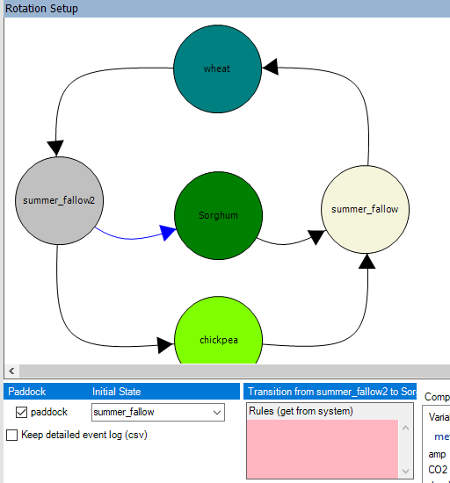
Crop rotations
Worked example: Add an opportunistic summer crop
Add crop component,
Add node & arcs,
Add manager & reconfigure it
Set rules & actions
Notes:
Walkthrough of adding rules & events

Slide 16
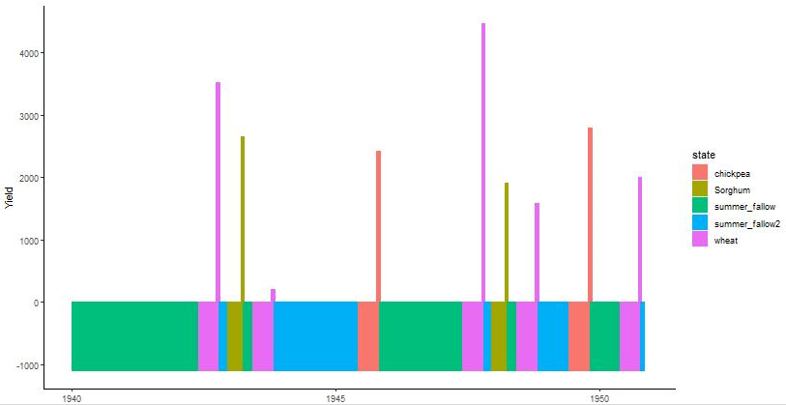
Crop rotations
Worked example: Add an opportunistic summer crop
Notes:
Walkthrough of adding rules & events

Slide 17
Crop rotations
Worked example: Interaction with custom manager script (irrigate)
Lucerne example from (https://www.apsim.info/support/apsim-training-manuals/crop-rotations/), complete example in the training toolbox
Notes:
Walkthrough of adding rules & events

Slide 18
Crop rotations
Worked example: Interaction with custom manager script (irrigate)
Add irrigation component (from toolbox) to simulation
Turn off automatic operation

Slide 19
Crop rotations
Worked example: Interaction with custom manager script (irrigate)
Add empty manager from toolbox
2 things: a rule (to test), and an action

Slide 20
Crop rotations
Worked example: Interaction with custom manager script (irrigate)
Implement the rule (aka variable) to test asw in top 3 layers each day
At some later time each day, the rotation manager will ask for it

Slide 21
Crop rotations
Worked example: Interaction with custom manager script (irrigate)
Implement the action (event handler) to irrigate when asked
The management rules (variables) are all tested repeatedly until there are no more candidates, so invalidate this rule immediately after irrigating

Slide 22
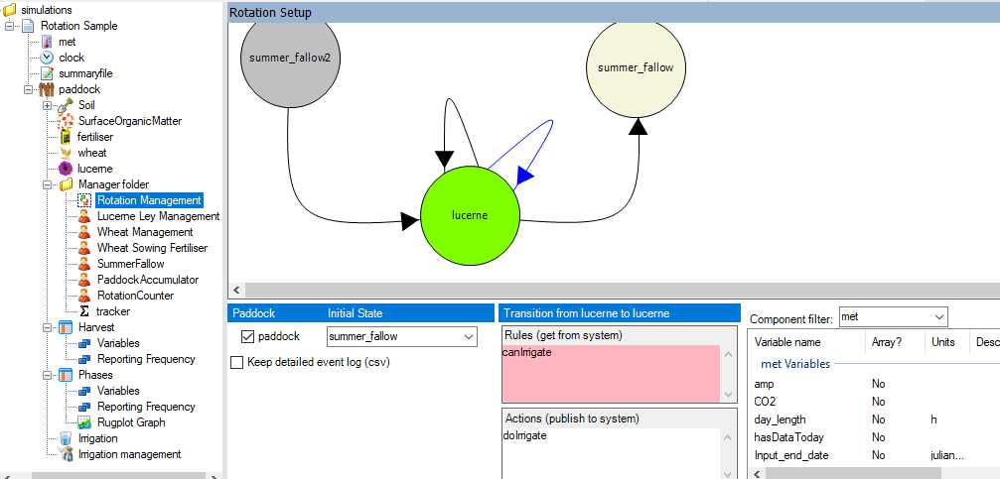
Crop rotations
Worked example: Interaction with custom manager script (irrigate)
Finally, add the rule & action to the DG

Slide 23
Crop rotations
Worked example: Interaction with custom manager script (irrigate)
Add some code to sum it up, add to output files
Notes:
How would we want to examine a) correct operation, and b) inclusion into results?

Slide 24
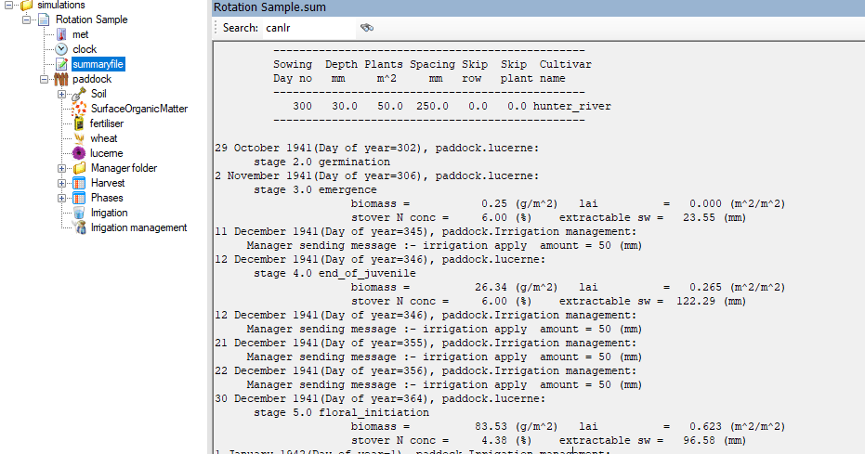
Crop rotations
Worked example: Interaction with custom manager script (irrigate)
Does it work?
Notes:
Correct operation 1. – the messages are sent

Slide 25
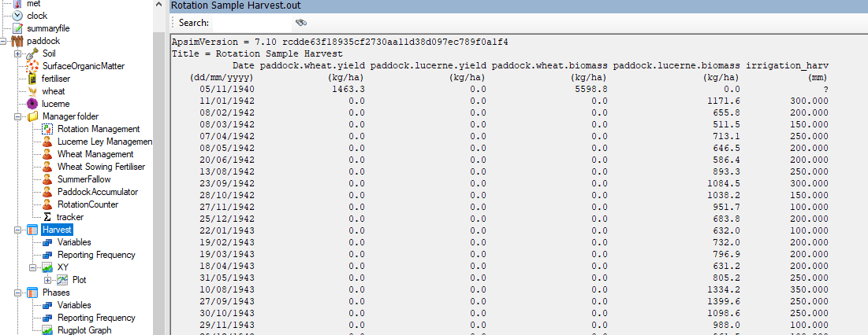
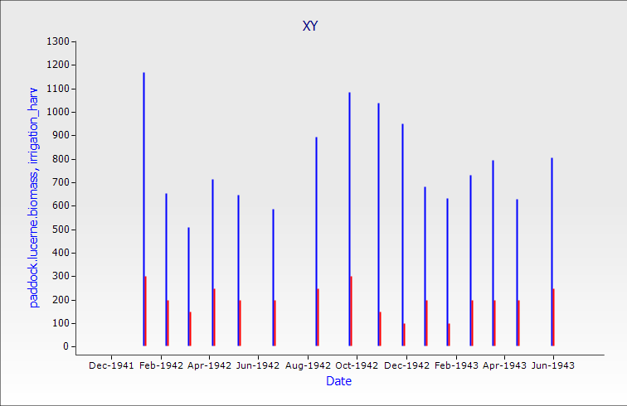
Crop rotations
Worked example: Interaction with custom manager script (irrigate)
Notes:
Correct operation 2. – the amounts are what we expected – vary from year to year, and are in the ballpark, though a bit high..

Slide 26
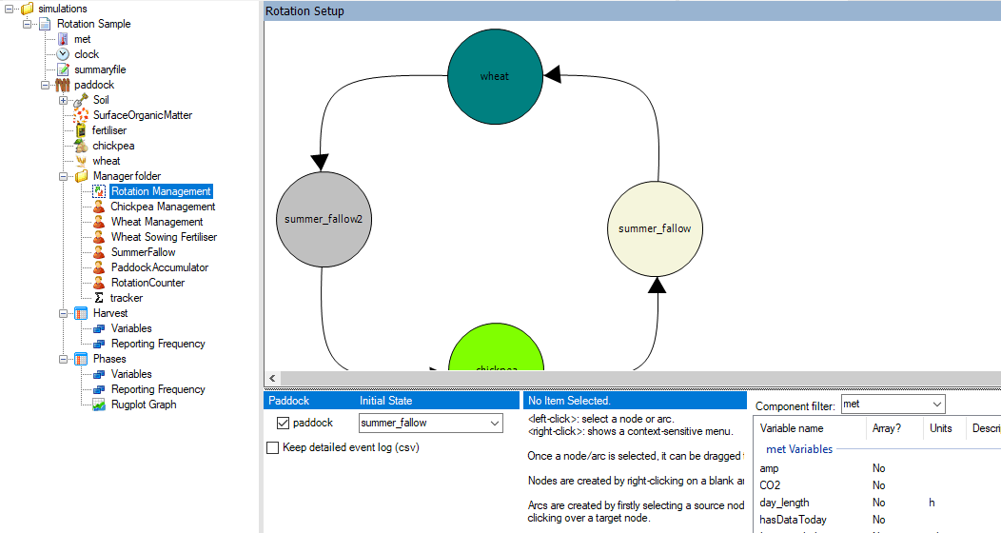
Crop rotations
Reporting: Phases vs Harvests

Slide 27
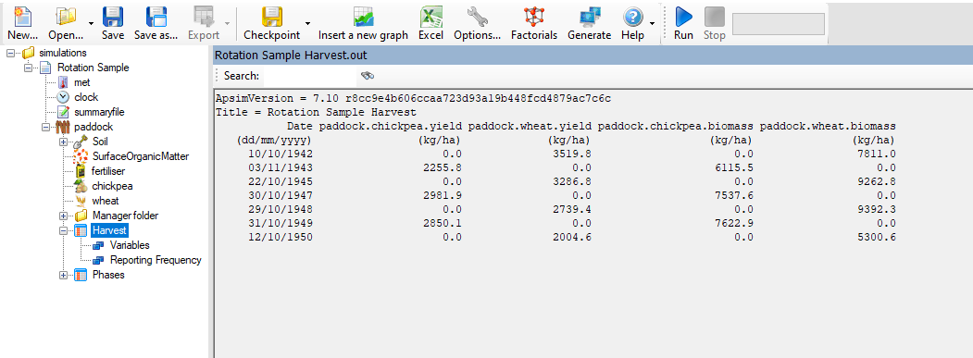
Crop rotations
Reporting: Harvests

Slide 28
Crop rotations
Reports on transition (leaving a phase)
Reporting: Phases
Which phase is being left

Slide 29
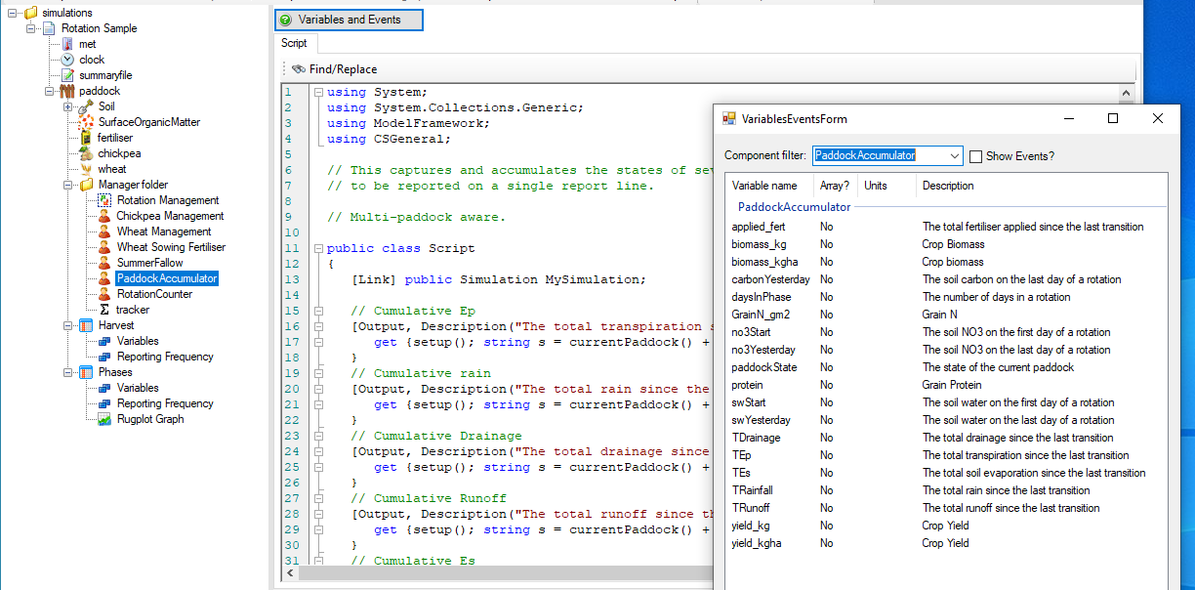
Crop rotations
Custom manager logic implements accumulators / trackers
Descriptions of each are in the variables list of that component

Slide 30
Crop rotations
‘Crop’ yield & biomass is simply the sum of all non-zero crops
(Intercrops won’t be correct)

