Slide 1
Crop rotations (APSIM 7.10)

Slide 2
Crop rotations
Options:
Linear (calendar) sequences (eg. Operations module)
State transition network (aka bubbles)
Some situations don’t require complex tools!
Flexibility a key philosophy of apsim
Notes:
Bigger perspective: possible approaches

Slide 3
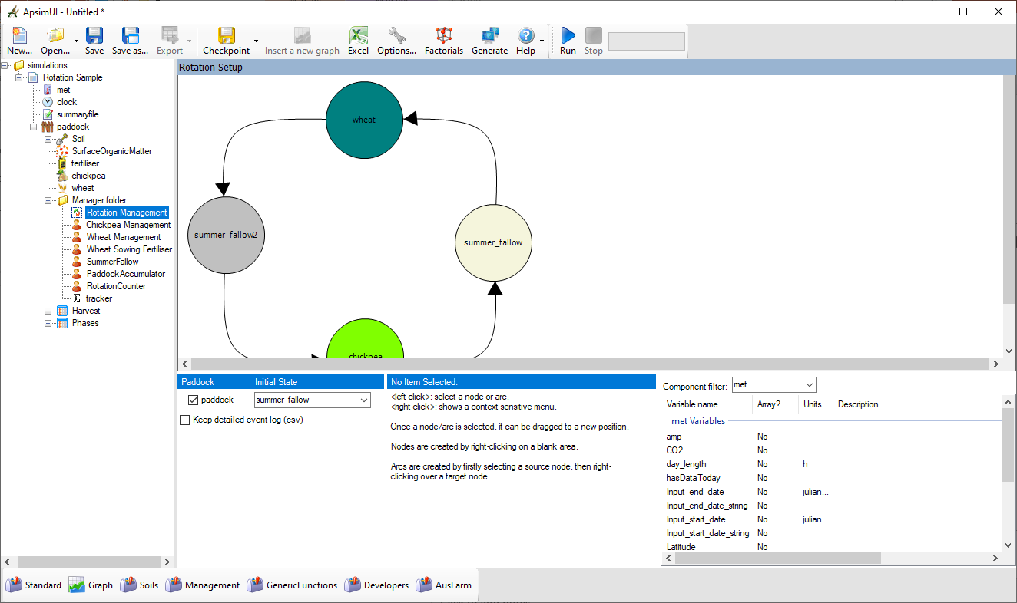
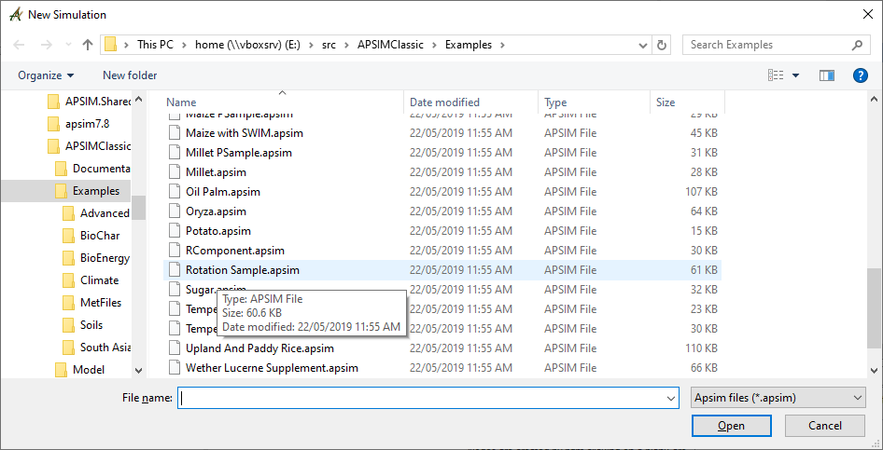
Crop rotations

Slide 4
Crop rotations
By itself, the crop rotation manager understands very little of the components it is interacting with.
It relies on other manager components for their specific knowledge
Normally, these other manager components* behave independently if they can’t see a sequencer in the simulation.
When a sequencer is present, they simply present variables that reflect the state of the crop they’re managing (eg sowing window is open today), and respond to directions when asked (eg sow the crop today).
* Only the manager.NET rules

Slide 5
Crop rotations
The sequencer’s daily operation is simple:
Can I do anything?
If so, do it
Repeat until nothing to do

Slide 6
Crop rotations
The sequencer’s daily operation is simple:
Can I do anything?
If so, do it
Is the chickpea crop ready to harvest?
No – do nothing
Yes – harvest, move to the next state, and see if there’s anything to do there..
Notes:
Example of a decision rule

Slide 7
Crop rotations
The sequencer asks the Chickpea Manager component whether the chickpea component is ready for harvest.
These rules have generic names that relate to states (enter & leave), not operations (sow & harvest).
Rules = variables → “get”
Actions = events → “publish”
Is the chickpea crop ready to harvest?
Yes – harvest, move to the next state, and see if there’s anything to do there..
Notes:
The mechanics of changing state

Slide 8
Crop rotations
UI Operation
Notes:
Operating the UI is described in center pane

Slide 9
Crop rotations
Nodes are abstract – they don’t have to represent a physical state in the system
They can be ephemeral – left immediately after entry
They can be partially disconnected (with only entry or exit arcs)
Tips:
Don’t use whitespace in names
Make sure the Initial State (starting point) exists
Don’t start in a crop, start immediately before that crop would be sown
Notes:
General construction

Slide 10
Crop rotations
Arcs must have a source and destination
A rule for an arc results in just an integer. The score for an arc is the mathematical product of all its rules
When evaluating multiple arcs from a node, the highest (non-zero) arc is selected
Tips:
In rules/actions, get module names exactly right (via copy/paste) – the writing is tiny
Start small & simple – test, and then expand the graph

Slide 11
Crop rotations
The sequencer runs at the process event of each day
Internally, the sequencer sends 3 events when changing state:
transition_from_X,
transition, and
transition_to_Y

Slide 12
Crop rotations
When it goes wrong:
Look in the summary file for error messages
Did you include a space in a node name?
If it’s empty (apart from initialisation messages), did you get initial state correct?
Check the phases output file for inordinately long phases – it may give a clue which rule is failing
Notes:
Common mistakes

Slide 13
Crop rotations
When it goes really wrong:
The “detailed log file” has the results of every rule evaluation
☒
☑
Notes:
How to work out what it’s doing

Slide 14
Crop rotations
Worked example: Interaction with custom manager script (irrigate)
Lucerne example from (https://www.apsim.info/support/apsim-training-manuals/crop-rotations/)
Notes:
Walkthrough of adding rules & events

Slide 15
Crop rotations
Worked example: Interaction with custom manager script (irrigate)
Add irrigation component (from toolbox) to simulation
Turn off automatic operation

Slide 16
Crop rotations
Worked example: Interaction with custom manager script (irrigate)
Add empty manager from toolbox
2 things: a rule (to test), and an action

Slide 17
Crop rotations
Worked example: Interaction with custom manager script (irrigate)
Implement the rule (aka variable) to test asw in top 3 layers each day
At some later time each day, the rotation manager will ask for it

Slide 18
Crop rotations
Worked example: Interaction with custom manager script (irrigate)
Implement the action (event handler) to irrigate when asked
The management rules (variables) are all tested repeatedly until there are no more candidates, so invalidate this rule immediately after irrigating

Slide 19
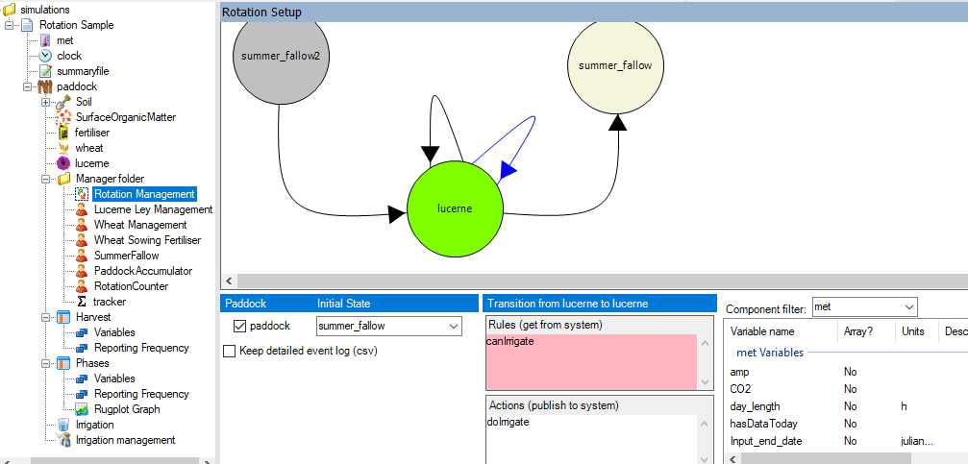
Crop rotations
Worked example: Interaction with custom manager script (irrigate)
Finally, add the rule & action to the DG

Slide 20
Crop rotations
Worked example: Interaction with custom manager script (irrigate)
Add some code to sum it up, add to output files
Notes:
How would we want to examine a) correct operation, and b) inclusion into results?

Slide 21
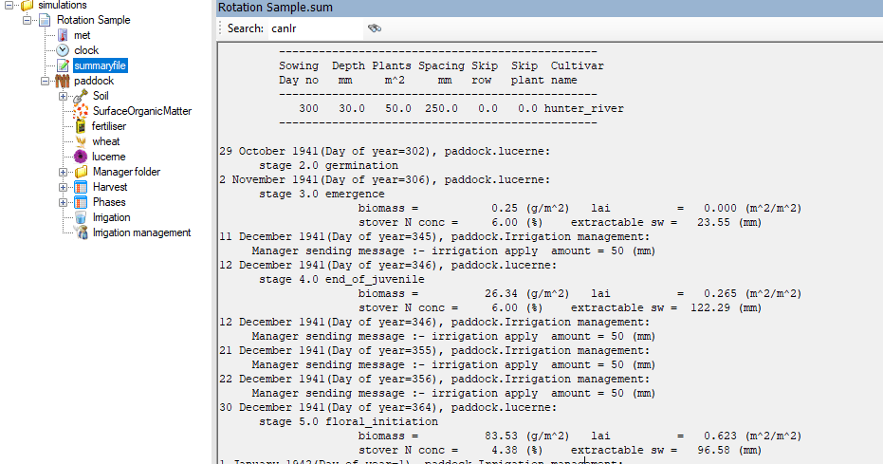
Crop rotations
Worked example: Interaction with custom manager script (irrigate)
Does it work?
Notes:
Correct operation 1. – the messages are sent

Slide 22
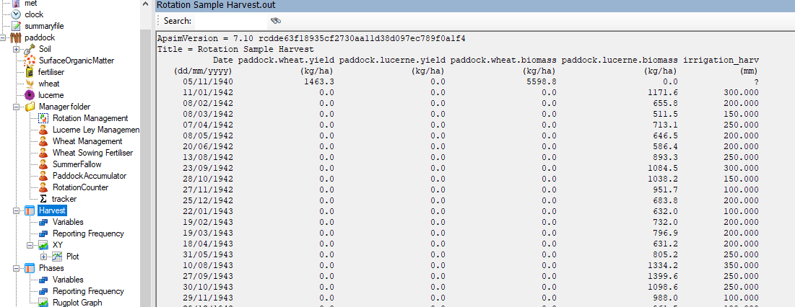
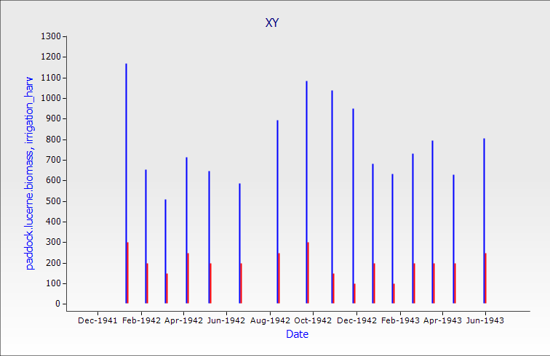
Crop rotations
Worked example: Interaction with custom manager script (irrigate)
Notes:
Correct operation 2. – the amounts are what we expected – vary from year to year, and are in the ballpark, though a bit high..

